Slide 1
Lexical Analysis

Slide 2
Responsibilities
Scans the input program
Removes white spaces
Removes comments
Extracts and identifies tokens
Generates lexical errors
Passes tokens to parser

Slide 3
Terminologies
Token: classification for a common set of strings
Examples: Identifier, Integer, Float, Operator,....
Pattern: The rules that characterize the set of strings for a token
Examples: [0-9]+
Lexeme: Actual sequence of characters that matches a pattern and has a given Token class
Examples:
Identifier: sum, data, x
Integer: 345, 2, 0, 629,....

Slide 4
Lexical Errors
Error Handling is localized with respect to the input source code
For example: fi (a == f(x)) … generates no lexical error in C
In what situations do errors occur?
Prefix of remaining input does not match any defined token
Possible error recovery actions:
Deleting or Inserting Input Characters
Replacing or Transposing Characters
Or, skip over to next separator to ignore problem

Slide 5
Overall strategy
Use one character of look-ahead
Perform a case analysis
Based on lookahead char
Based on current lexeme
Outcome
If char can extend lexeme, continue.
If char cannot extend lexeme, find what the complete lexeme is (upto the previous character) and return its token. Put the lookahead back into the symbol stream.

Slide 6
Regular expressions
Ɛ is a regular expression, L(Ɛ) = {Ɛ}
If a is a symbol in ∑, then a is a regular expression, L(a) = {a}
(r) | (s) is a regular expression denoting the language L(r) ∪ L(s)
(Strings from both languages)
(r)(s) is a regular expression denoting the language L(r)L(s)
(Strings constructed by concatenating a string from the first language with a string from the second language)
(r)* is a regular expression denoting (L(r))*
(Each string in the language is a concatenation of any number of strings in the language of s)
(r) is a regular expression denoting L(r)

Slide 7
Regular expressions
Examples:
letter → A | B | … | Z | a | b | … | Z | _
digit → 0 | 1 | … | 9
id → letter (letter | digit)*

Slide 8
Regular expressions
Extensions
One or more instances: (r)+
Zero of one instances: r?
Character classes: [abc]
Example:
letter → [A-Za-z]
digit → [0-9]
id → letter(letter|digit)*

Slide 9
Transition diagrams
An additional character is read, that needs to be unread(return to input buffer

Slide 10
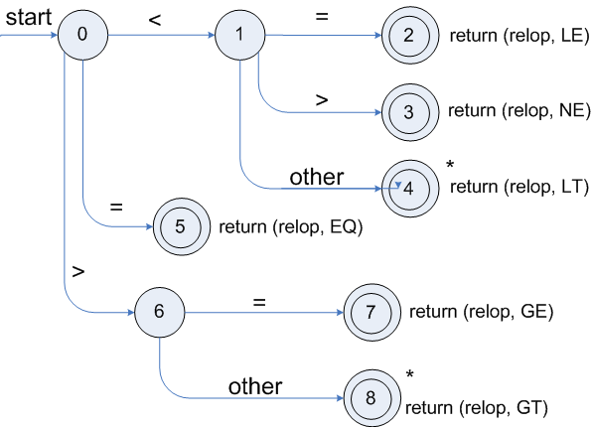
Transition diagrams
For relational operators

Slide 11
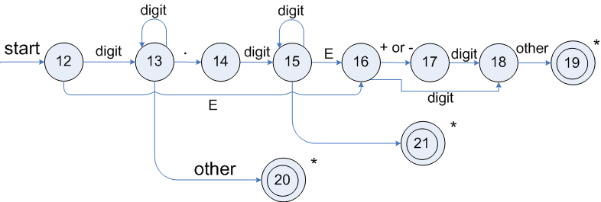
Transition diagrams
For unsigned numbers

Slide 12
Transition diagrams
For identifiers
What to do for keywords?
Use the “Identifier” token
After a match, lookup the keyword table
If found, return a token for the matched keyword
If not, return a token for the true identifier

Slide 13
Recognising Tokens
Regular expressions provide specifications for the tokens in a language
Finite automaton is used to recognise a token – implementation
A finite automaton consists of
An input alphabet Σ
A set of states S
A start state n
A set of accepting states F ⊆ S
A set of transitions state →^{input} state

Slide 14
Finite Automaton
Deterministic Finite Automata (DFA)
One transition per input per state
No ε-moves
Nondeterministic Finite Automata (NFA)
Can have multiple transitions for one input in a given state
Can have ε-moves
Finite automata have finite memory
Need only to encode the current state
Conversion can be automated
NFAs and DFAs recognize the same set of languages (regular languages)
DFAs are easier to implement

Slide 15

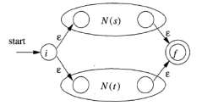

Regular Expressions to NFA McNaughton-Yamada-Thompson Algorithm
For each kind of regular expression, define an NFA
For r=ε
For r=a
ε
For r=s | t
For r=st

Slide 16
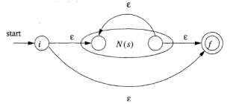
Regular Expressions to NFA McNaughton-Yamada-Thompson Algorithm
For r = s*

Slide 17


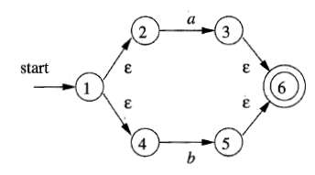
Example: (a|b)*abb
a
b
a | b

Slide 18
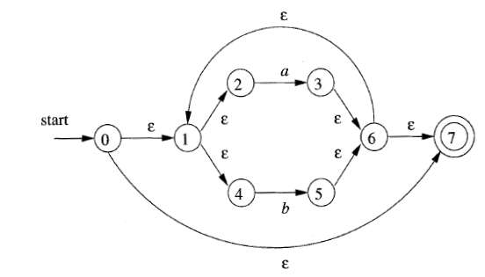
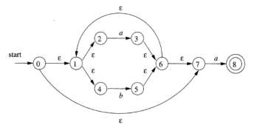
Example: (a|b)*abb
(a|b)*
(a|b)*a

Slide 19
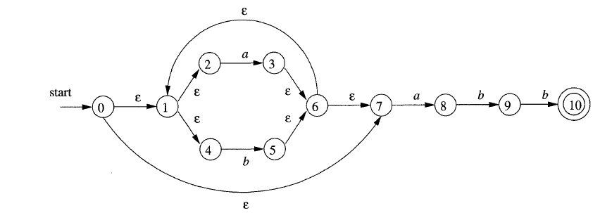
Example: (a|b)*abb
(a|b)*abb

Slide 20
Converting NFA to DFA
Subset construction: each state of DFA corresponds to a set of NFA states
For real languages NFA and DFA have approximately the same number of states (though not theoretically)

Slide 21
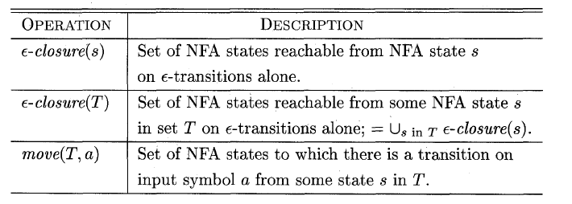
Definitions

Slide 22
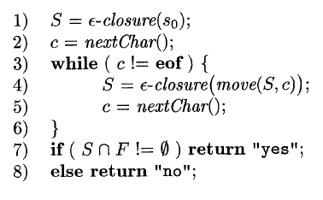
Simulating NFA

Slide 23
Computing ɛ-closure
Push all states of T onto stack;
Initialize ɛ-closure(T) to T;
while (stack is not empty) {
pop t, the top element of the stack
for (each state u with an edge from t to u
labeled ɛ)
if (u is not in ɛ-closure(T))
{ add u to ɛ-closure(T))
push u onto stack
}
}

Slide 24
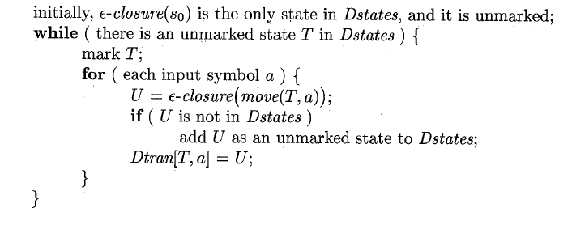
Subset Constructions
States of the DFA we are constructing

Slide 25
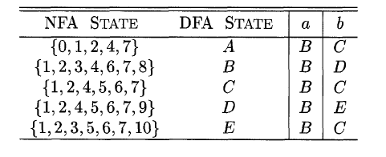
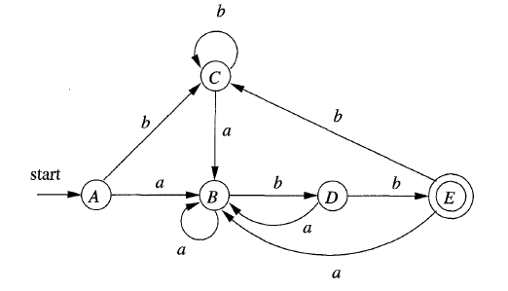
The resulting DFA

Slide 26
Construction of DFA directly from RE
Augment the regular expression r with a special end symbol # to make accepting states important
the new expression is r#
Construct a syntax tree for r#
Attach a unique integer to each node that is not labeled by ε

Slide 27
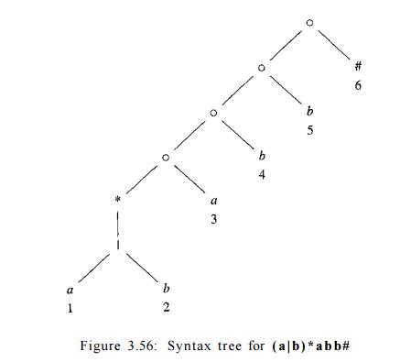
Syntax tree for regular expression (a|b)*abb #

Slide 28
Annotating the tree
Traverse the tree to construct functions nullable, firstpos, lastpos, and followpos
For a node n, let L(n) be the language generated by the subtree with root n
nullable(n): L(n) contains the empty string ε
firstpos(n): set of positions under n that can match the first symbol of a string in L(n)
lastpos(n): the set of positions under n that can match the last symbol of a string in L(n)
followpos(i): the set of positions that can follow position i in any generated string

Slide 29
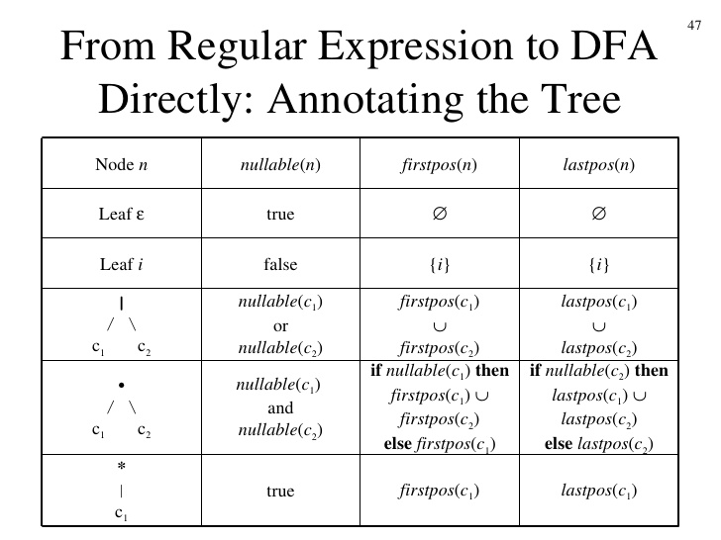
Computation of nullable, firstpos, lastpos

Slide 30
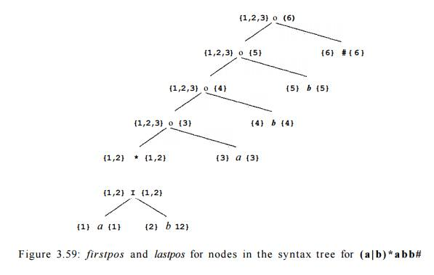

Slide 31
C(L|D)*LLS
Construct NFA and then DFA using subset construction
Construct DFA directly from the RE

Slide 32
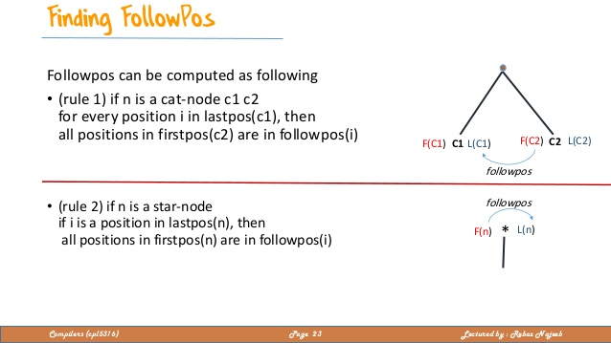
Evaluating followpos
Two-rules for followpos:
If n is concatenation-node with left child c₁ and right child c₂ , and i is a position in lastpos (c₁), then all positions in firstpos(c₂) are in followpos(i).
If n is a star-node, and i is a position in lastpos(n), then all positions in firstpos(n) are in followpos(i).
After computing firstpos and lastpos for each node, followpos of each position can be computed by making one depth-first traversal of the syntax tree.

Slide 33
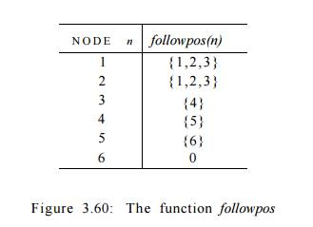

Slide 34
The Algorithm
Initialize Dstates to contain only the unmarked state firstpos(n_{o}), where n_{o} is the root of syntax tree T for ( r ) #
while ( there is an unmarked state S in Dstates ) {
mark S;
for ( each input symbol a ) {
let U be the union of followpos(p) for all p in S
that correspond to a;
if ( U is not in Dstates )
add U as an unmarked state to Dstates; Dtran[S, a] = U;
}
}

Slide 35
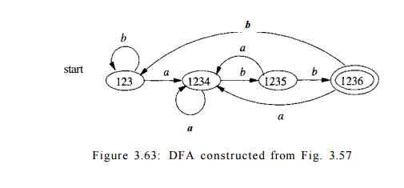

Slide 38
Minimizing number of DFA states
For any regular language, there is always a unique minimum state DFA, which can be constructed from any DFA of the language.
Algorithm:
Partition the set of states into two groups:
G 1 : set of accepting states
G 2 : set of non accepting states
For each new group G
partition G into subgroups such that states s1 and s2 are in the same group, iff for all input symbols a, states s1 and s2 have transitions to states in the same group
Start state of the minimized DFA is the group containing the start state of the original DFA
Accepting states of the minimized DFA are the groups containing the accepting states of the original DFA.

Slide 39
Minimizing DFA –Example (1)

Slide 40
Minimizing DFA –Example (2)

Slide 41
Architecture of a Lexical Analyzer

